Slide 1
Project of integration of sustainable development in the master programmes
Leo Yeung and Ingrid Ericson Jogsten
Notes:
Title of our master programme(s)

Slide 2
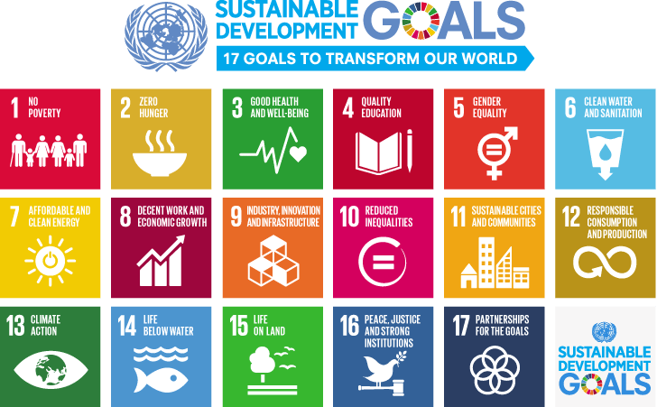
Sustainability/Sustainable development
“Sustainable development” is development that meets the needs of the present without compromising the ability of future generations to meet their own needs

Slide 3
International Master Programme
Master Programme in Chemistry in Environmental Forensics
Nordic Master Programme in Arctic Environmental Forensics
The Transport of Pollutants in Soil, Water, and Air
Analytical Methods in Environmental Forensics I
Analytical Methods in Environmental Forensics II
Environmental Toxicology
Health Impacts of Environmental Exposure
Sustainability, Chemical Safety and the Environment
Independent Project for the Degree of Master (120 Credits) in Chemistry

Slide 4
International Master Programme
Master Programme in Chemistry in Environmental Forensics
Nordic Master Programme in Arctic Environmental Forensics
The courses in these programmes are in line with the ecological dimension of sustainable development
The Transport of Pollutants in Soil, Water, and Air
Analytical Methods in Environmental Forensics I
Analytical Methods in Environmental Forensics II
Environmental Toxicology
Health Impacts of Environmental Exposure
Sustainability, Chemical Safety and the Environment
Independent Project for the Degree of Master (120 Credits) in Chemistry

Slide 5
International Master Programme
Master Programme in Chemistry in Environmental Forensics
Nordic Master Programme in Arctic Environmental Forensics
But…
Social and economic aspects are not the focus
The Transport of Pollutants in Soil, Water, and Air
Analytical Methods in Environmental Forensics I
Analytical Methods in Environmental Forensics II
Environmental Toxicology
Health Impacts of Environmental Exposure
Sustainability, Chemical Safety and the Environment
Independent Project for the Degree of Master (120 Credits) in Chemistry

Slide 6
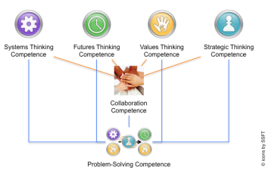
Key competencies for sustainable development
What competencies do we need?
Wiek, A., Withycombe, L. & Redman, C.L. Key competencies in sustainability: a reference framework for academic program development. Sustain Sci 6, 203–218 (2011). https://doi.org/10.1007/s11625-011-0132-6
10. UNESCO [United Nations Educational Scientific and Cultural Organisation]. Education for Sustainable Development Goals: Learning Objectives; UNESCO: Paris, France, 2017; pp. 1–67.
Notes:
What competencies do you need?

Slide 7
Key competencies for sustainable development
What competencies do we need?
Aligns with University’s vision
Örebro University is a place for education, further training, and lifelong learning.
Wiek, A., Withycombe, L. & Redman, C.L. Key competencies in sustainability: a reference framework for academic program development. Sustain Sci 6, 203–218 (2011). https://doi.org/10.1007/s11625-011-0132-6
10. UNESCO [United Nations Educational Scientific and Cultural Organisation]. Education for Sustainable Development Goals: Learning Objectives; UNESCO: Paris, France, 2017; pp. 1–67.
Notes:
What competencies do you need?

Slide 8
Problem-based learning (PBL)
9. J Donnér and G Edgren (2015) Högre utbildning Vol. 5, Nr. 1, 2015, 35-45
Notes:
By including PBL work as part of your studies we wish for you to develop other skills, such as critical thinking, collaboration and communication. With PBL case studies we want you to develop habits and skills for researching information and solving problem. All skills hopefully very useful in your future careers.

Slide 9
Approach
(1) forming a working group consisting of programme coordinator, head of unit, and course responsible teachers to identify possible key courses for sustainable development throughout the education.
(2) evaluate current situation on what key courses have been identified, content and learning activities that might already be linked to sustainable development.
(3) create different learning activities to integrate sustainable development in different courses

Slide 10
Challenges/Opportunities (I)
The Transport of Pollutants in Soil, Water, and Air
Analytical Methods in Environmental Forensics I
Analytical Methods in Environmental Forensics II
Environmental Toxicology
Health Impacts of Environmental Exposure
Sustainability, Chemical Safety and the Environment
Independent Project for the Degree of Master in Chemistry

Slide 11
Challenges/Opportunities (II)
Not to change anything in our current course to adapt sustainable development
Students having different background and knowledge
Some students are weak in discussion in class
Challenge to get all teachers engaged and involved
Notes:
Challenge to get all teachers engaged and involved.

Slide 12
Activities used/using
PBL teaching approach/case studies
Advancing Education For Sustainability – Transforming Society, Economy and Environment (advancingesd.com)
SDG Impact Assessment Tool
Online quiz developed by Dr. Johanna Björklund (Wiseflow)
Notes:
Should we list any previous activities? PBL throughout the programme to let students train communication, critical thinking and collaboration. Analysis of own human samples to enhance interest and discussion when comparing the results
Role play in environmental law case (gather information, presentation, argumentation) representing different sides (company, regional county board) Other things?

Slide 13
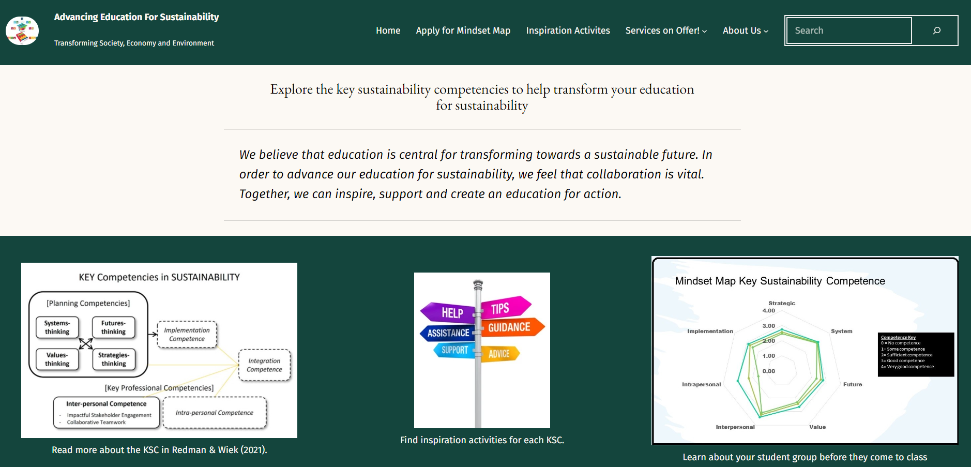

Slide 14
Online quiz developed
2 hours to complete the test
Last four questions are related to their perception and will be discussed among themselves

Slide 16
Notes:
Individual assessment first, then shared group discussion. The students did the work themselves. Learned new things when using the material but also new perspectives from the discussion with their peers.

Slide 17
Feedback from students
”Very student centred”
”there are so much details on different goals”
”interesting discussion”
”why would he/she think like this”
”can we create our own topics”
”why do we need this, I am studying chemistry programme”
https://integritydlm.net/values-game/?lang=en

Slide 18
Notes:
Did you add information on this in the beginning? And maybe also add information on the social event. Experiencing Swedish nature and The right of public access (Allemansrätten).

Slide 19
Learning in the nature (Harge uddar)
Social events in the first week
Readings related to the environment
Share their thoughts with others and their expectations to the programme
Notes:
Experiencing Swedish nature and The right of public access (Allemansrätten).

Slide 20
On-going plan
Implement the SDG impact assessment tool throughout the programme with different topics related to the course contents
2nd year student will help with making topics as they have taken the course
1st year student will prepare topics for next year students
Teachers will choose relevant topics for discussion

Slide 21
Short summary
These activities promote inquiry-based, collaborative, constructivist, reflective, and integrative approaches to enhance student learning.

Slide 22
Acknowledgements
ENT Faculty for funding this work
Alice Annelin and Gert-Olof Boström from Umeå University
Dr. Johanna Björklund and her team (ORU)
Current master students and alumni students
Teachers from MTM (Mattias, Maria, Tuulia, Steffen)

Slide 23
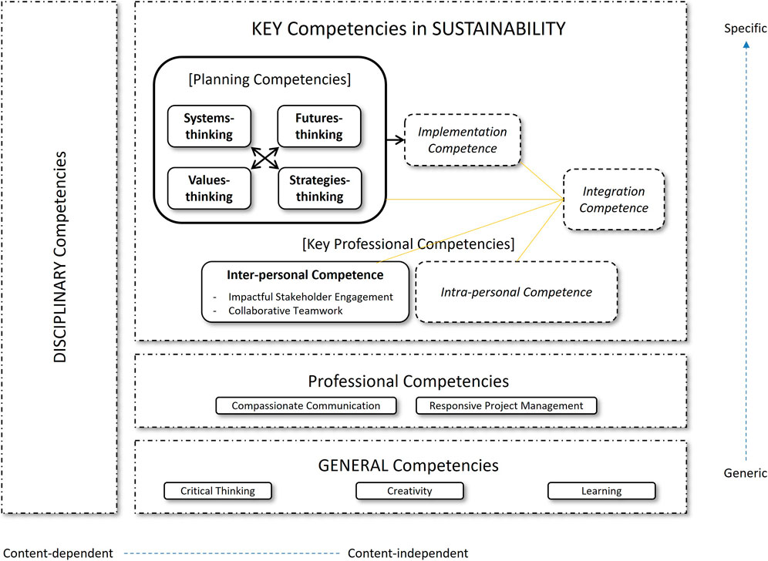
Key competencies for sustainability
Aaron & Wiek, 2021, Competencies for Advancing Transformations Towards Sustainability, Frontiers in Education, Vol 6, https://www.frontiersin.org/articles/10.3389/feduc.2021.785163

